Slide 1


Enhancing Morningstar’s Match API
Yuva raj Balla, Qurrathul Ain Majid, Payton Malpeli, Bhumanyu Singh Ranawat, and Liana Cramb

Slide 2
Introduction
Objective & Purpose
Descriptive Analysis
Predictive Analysis
Key Takeaways
Recommendations
Agenda

Slide 3
About Morningstar
Global leader in investment research and data analytics
Focus on data driven innovation
Extensive product ecosystem
Empowering investor success by delivering transparent and reliable financial information
Notes:
Point 1 – Provide independent insights on securities, funds, and portfolios to empower investor success
Point 2 – Morningstar continuously leverages machine learning and automation to enhance data accuracy, classification, and matching processes.
Point 3 – Platforms like Illume and Portfolio DataManager leverage Morningstar’s data and APIs to deliver accurate, efficient, and scalable investment insights.
Point 4 – Their mission is all about empowering investor success. Morningstar’s tools and technology support transparency, efficiency, and better decision-making for investors and financial professionals worldwide.

Slide 4

Objective & Purpose
Develop a machine learning model to predict detail holding type using ExternalName
Compute and analyze prediction quality & computation efficiency of modeling approaches
Enhance Match APIs ability to subset and route holdings data to reduce false positives and improve overall match precision
Create a model which can be easily updated with new data
Deliver insights for further improvements

Slide 5
Descriptive Analysis
Variable | Number of Unique Observations
Morningstar Dataset | 398,343
Date Range | June 2019– June 2024
DetailHoldingTypeId | 104
ExternalName | 211,738

Slide 6
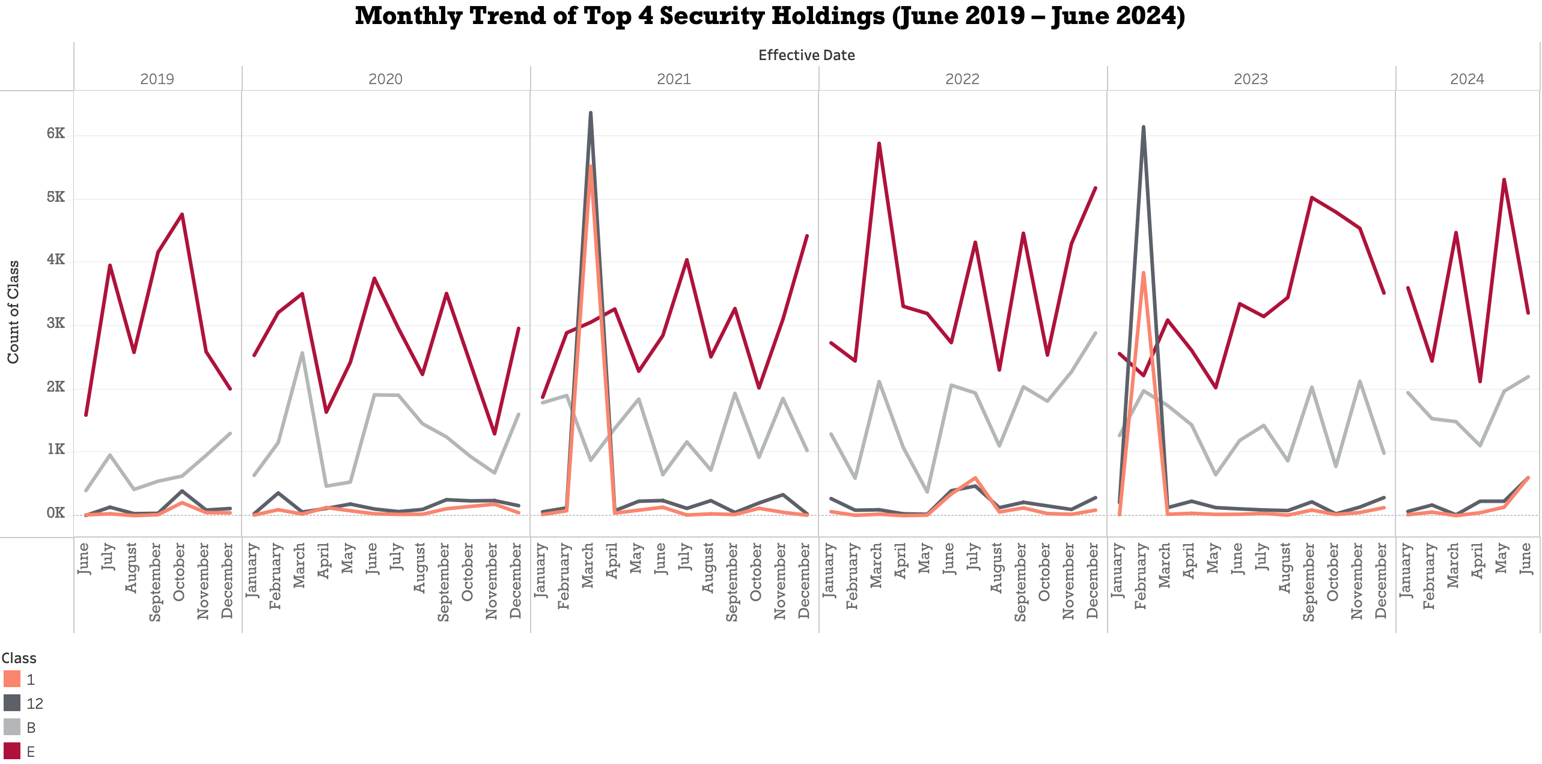
Equity (E): Top security holding; ownership, voting rights, strong long-term returns.
Corporate Bonds (B): Second most frequent; higher yields, attract income investors.
Municipal Bonds (1, 12): Tax-free income; gained popularity in early 2021 and 2023 with rising tax revenues and market uncertainty.

Slide 7
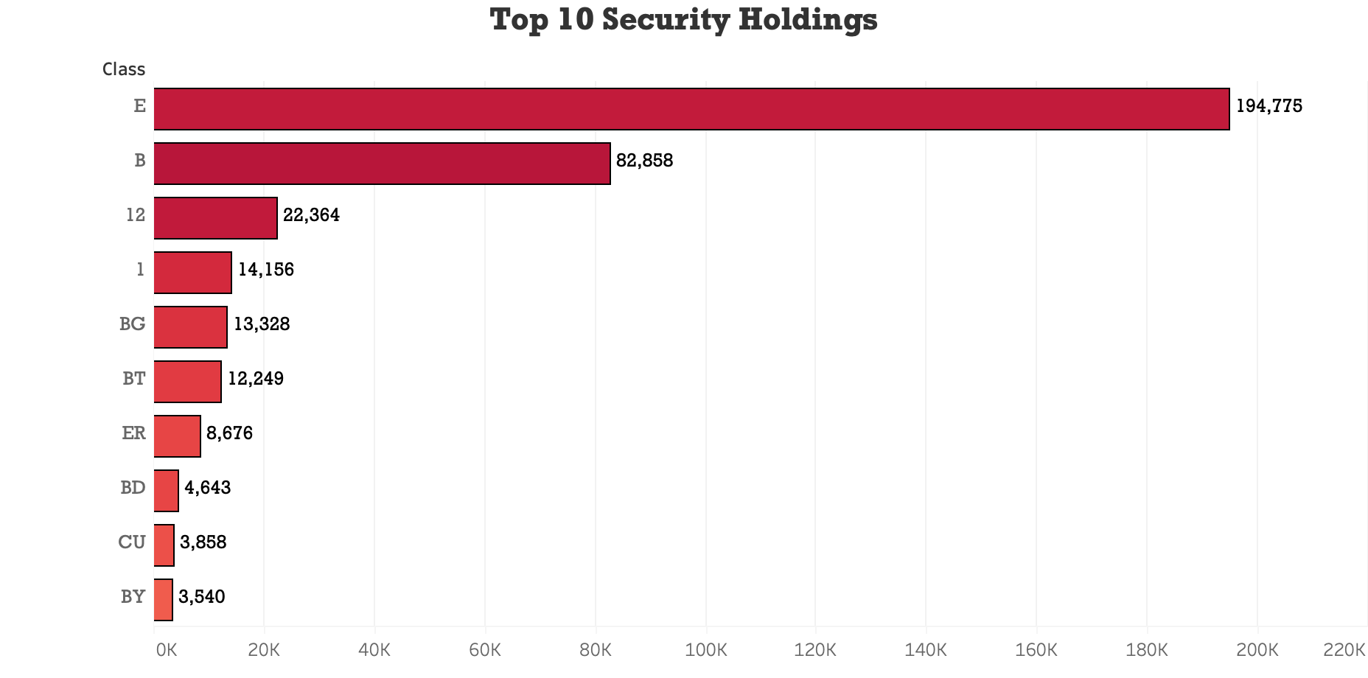
Top 5 – E, B, 12, 1, BG: These are broad, accessible investments that offer attractive returns or tax benefits. Their familiarity and stability make them popular among a wide range of investors.
Bottom 5 – BT, ER, BD, CU, BY: These are more specialized holdings used for specific purposes rather than broad investing. Their complexity, lower returns, and higher risks limit investor participation, leading to lower frequency in the data.

Slide 8
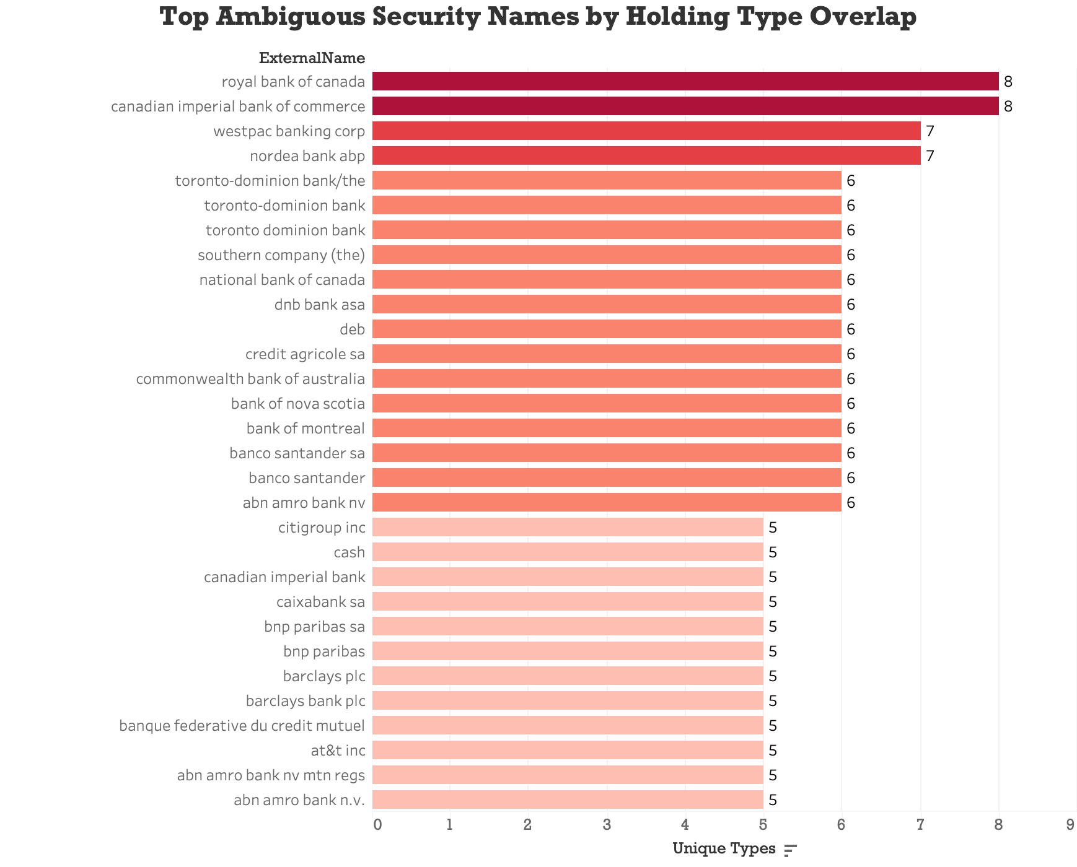
Certain issuer names appear under multiple holding types.
Indicates inconsistent label assignment for the same security name.
Creates high confusion risk when predicting security type using name-only data.
Suggests that naming alone does not reliably indicate holding classification.

Slide 9
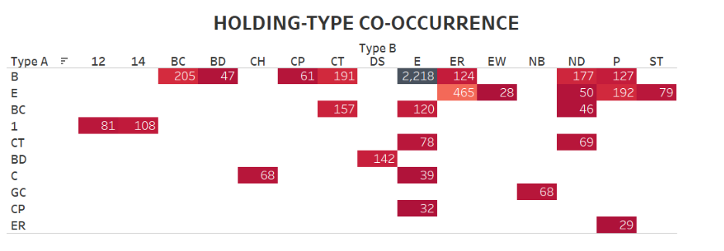
Some holding types share large overlaps in referenced security names.
Indicates that category boundaries are not clearly separated in the underlying data.
Reveals structural ambiguity between certain security types (e.g., B ↔ E, E ↔ ER).
Confirms that a portion of misclassification risk is inherent to the dataset, not just the model.

Slide 10
Model – Random Forest Full Classification
Approach
Removed ExternalId and converted variables to factors
Split dataset into 70% training / 30% testing
Trained a multi-class random forest classifier with:
600 trees
2 randomly selected features
Gini
Used OOB error and a detailed confusion matrix for evaluation
Predictive Model: Approach 1
Notes:
For Gini, we used this to maximize how cleanly the model separated holdings into their respective classification types
OOB=Out of Bag

Slide 11
Results
Metric | Value | Description
Accuracy | ~ 87% | Overall Model Performance
Precision (avg.) | ~ 79% | Correctly predicted holdings
Recall (avg.) | ~ 69% | Ability to capture true classes
F1 Score (avg.) | ~ 71% | Overall Model Effectiveness
The model performed very well on major classes (E, BG, ER) but struggled on smaller categories (BD, BY, Class 1).
The imbalance caused a drop in average recall and F1

Slide 12
Predictive Model Approach 2
Model – Multi class XGBoost
Approach
Cleaned and normalized text
Applied TF-IDF vectorization to transform text into numeric features.
Split data using stratified sampling to preserve class balance (70/30)
Trained a multi class XGBoost model with the following parameters – eta = 0.2, max_depth = 8, nrounds = 1000

Slide 13
Results
Metric | Value | Description
Accuracy | ~ 90% | Overall Model Performance
Precision (avg.) | ~ 93% | Correctly predicted holdings
Recall (avg.) | ~ 91% | Ability to capture true classes
F1 score (avg.) | ~ 92% | Overall Model Effectiveness
Model showed strong performance on frequent holding types, but there was a decline for low-frequency classes (i.e BD and BY)
Error analysis showed misclassification mainly between similar text or related classes.

Slide 14
Final Predictive Modeling Process
Input: ExternalName converted into numeric TF-IDF features and removed rare BD external names
Data Split: 70% training and 30% testing)
Algorithm Used: XGBoost (Name-Only Classification)
Created both word-level (1–2 grams) and character-level (3–5 grams) features
Applied TF-IDF to highlight important and meaningful terms
Output: DetailHoldingTypeId (101 unique classes)

Slide 15

Model Setup and Training
Converted labels to numeric (factor) format
Built DMatrix for faster XGBoost processing
Objective: multi:softprob Metrics: mlogloss, merror
Trained until performance became stable and accurate
Used train + validation watchlist to monitor learning

Slide 16
Model Results and Evaluation
Evaluating accuracy and balance of our model’s performance
F1 scores > 0.85
Precision and recall are closely aligned
Notes:
This chart compares F1 score, precision, and recall across the top 10 most frequent classes so we can evaluate both the accuracy and balance of our model’s performance. There is high performance consistency across all top 10 categories (F1 score above 0.85). The precision and recall metrics are also closely aligned suggesting that the model is not overly biased towards false positives or false negatives.

Slide 17
Key Takeaways
Model shows strong performance (93% accuracy, 0.93 Macro F1 score)
Reliable classification
Can reduce false positives and manual review in the Match API workflow
Provides scalable value
Notes:
Point 1 – Ready for production use
Point 2 – enables automated pre-matching
Point 4 – across products like Illume and Portfolio DataManager

Slide 18
Recommendations
Use as a pre-matching filter to subset holdings before full match processing
Incorporate confidence-based routing
Expose prediction confidence within user interface
Monitor business impact to measure ROI and guide scaling
Notes:
Point 2 – Which will prioritize high certainty to matches and flag uncertain ones
Point 3 – This can be used as a tool to establish trust in automated matching results
One last thing we’d like to note is that integrating this model into the match api workflow would not come at a huge cost

Slide 19
Thank You!
Questions?

